Slide 1
S.E.O.
What we need to do for every site we build

Slide 2
What is SEO?
It stands for Search Engine Optimization
It is the process of improving the volume and quality of traffic to a web site from search engines via "natural" ("organic" or "algorithmic") search results for targeted keywords.
http://en.wikipedia.org/wiki/Search_engine_optimization

Slide 3
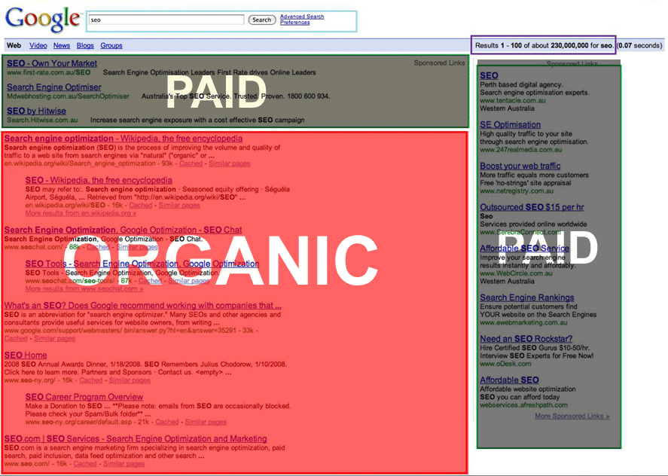
In English please?
In essence it is about improving the position of your site on a Search Engine Results Page (SERP) in response to a keyword query.
The earliest known use of the phrase "search engine optimization" was a spam message posted on Usenet on July 26, 1997

Slide 4
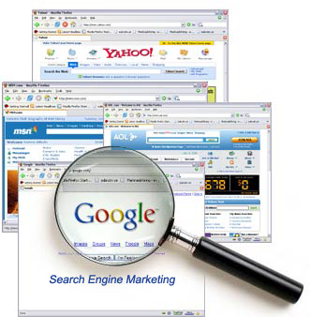
Why is it important?
Google does 91,000,000 searches a day. There are 266,848,493 unique websites. There are 2,095,006,005 internet users.
How is our audience going to find us?
http://searchenginewatch.com/2156461 http://www.newsofdelhi.com/internet/how-many-websites-are-there http://www.internetworldstats.com/stats.htm

Slide 5
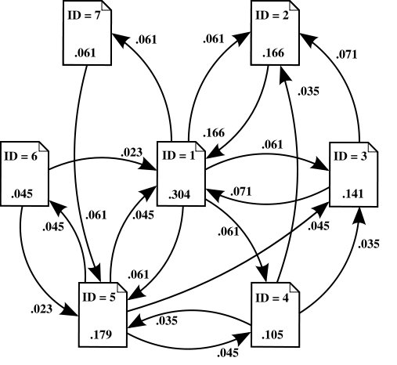
What is PageRank?
PageRank is a link analysis that assigns a numerical weight to each page. It is Google’s weighting of the importance of the page. PageRank is named after Larry Page one of the
founders of Google.
http://en.wikipedia.org/wiki/pagerank

Slide 6
How does it work?
A search engine spider “crawls” your site and indexes the information on the pages. The page is then assessed for it’s authority on the subject. The higher the authority,
The higher you are in the results. The more people link to you the higher authority you are.

Slide 7
Is that it, just get more links?
No! Many more things come into the calculation of results. The page formatting, scripting, & keyword density all come into play. That is why SEO is everyone’s responsibility, not just developers’.

Slide 8
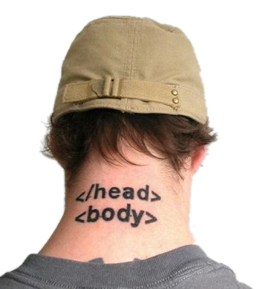
What do you mean by formatting?
It refers to the way the page is constructed. The HTML needs to be tidy and CSS based, tags need to be closed,
and any scripts need to
be in the right place
(external linked file).

Slide 9
Are there standards?
Yes! Your code should be W3C validated. You can use http://validator.w3.org to validate your code.
(Do not panic if your site generates some errors. Even Google homepage does)

Slide 10
Is meta-data still important?
Sort of. Their influence declined with search engines due to spamming. For Google they do not matter, however some meta-data tags are still useful.
They are used by GSA, robots, favicons, results descriptions, DMOZ and more…

Slide 11
What about keywords?
Search engines pay special attention to the key words in your title and headings because they expect headings to include clues to the page’s main topics. It is essential that your title, headlines and beginning copy include these
keywords.

Slide 12
What effect does copywriting have on SEO?
Search Engines will read around 1000 words of copy on a page to see if the title, H1 and headlines match the copy. Therefore pages of copy should have no more than 1,000 words of copy per page. The keywords should be peppered throughout
the copy.
But not to the point of copy idiocy.

Slide 13
So I should write for spiders?
No. Content is still King. So is Elvis. Deal with it. If you have compelling copy people will link to you. If people link, spiders and engines will find you. If they find you, they will list you. If they list you the more people will find you. If more people
find you they will read your compelling copy. And the cycle repeats and SEO happiness ensues.

Slide 14
So how should I write?
You should choose between 4 to 6 keywords, that you wish to be in the top 10 for on the search engines and optimize for those words. For the long-tail words and phrases, utilize SEM to capture those searches.

Slide 15
What is SEM?
SEM stands for search engine marketing. In a nutshell it is paid search results. For advertisers is has the added advantage of providing metrics on
impressions and
clicks.
Warning: Google has changed so that you will pay more for keywords that are superfluous.

Slide 16
What else can I do? (I have no budget)
There are lots of ways you can increase the SEO of your site. As we have seen links are good. So how do you get more links?
Link building, social link building and link baiting are all methods of building up SEO.

Slide 17
What is Link Building?
Link building is the process of creating inbound links to your website. This can be as simple as reciprocal links, links from online articles, newsletters, directories and more.
The catch is quality counts, and counts BIG. The higher the PageRank of someone linking to you the better.

Slide 18
What is Social Link Building?
Social link building is using sites such as Digg, Stumblupon, Reddit, Del.icio.us, Facebook & Twitter to allow users to share links to your website.
In most of these sites
a record of the
link persists.

Slide 19
What is Link Baiting?
Link baiting is an SEO term used to describe content created to generate links. The idea is that you create something of interest that people will respond to. Examples of link bait include: top 10 lists, interviews, special reports, free tools, contests, controversy, compilations, contradictions, humour, and more…

Slide 20
Wait, isn’t that black hat?
No. Black hat refers to any technique used to achieve higher search rankings that is unethical. Examples include keyword stuffing, invisible text and doorway pages. Stay away from black hat or you will get PWND! Link baiting is providing content people want, in an easily digestible form.

Slide 21
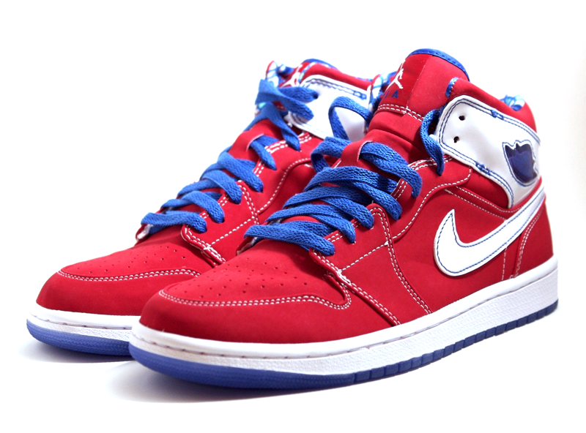
SEO is part of user experience
Web Analysts can provide information on organic search terms people use to find your site. In turn, sites should be structured around how people search. For example if your customers search for “sneakers”, rather than “running shoes” label that category accordingly.

Slide 22
What about internal search?
Our GSA enables us to control the internal search only. SEO and the Search appliance are completely separate. We can feed the GSA content we cannot feed to public Google.
However, the changes we make for SEO will improve the accuracy of our own results.

Slide 23
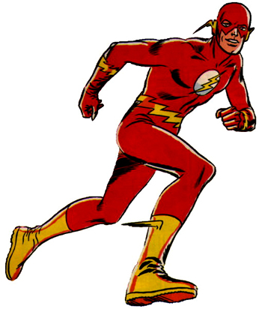
Flash and SEO?
Flash is not SEO suicide anymore. Just take a look at Rolex.com. It does however involve some additional work to place engine readable content in a div that gets replaced by the Flash content using JavaScript. This isn’t considered black hat as long as the content in the div matches the content in the Flash.

Slide 24
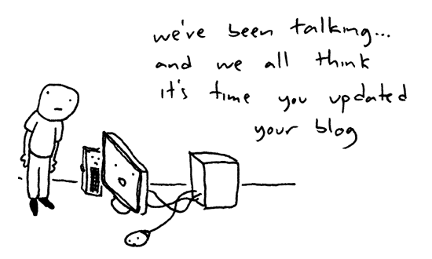
Blogs and SEO?
Blogs can be a handy tool to get your site ranked higher if you are dedicated to frequently posting on topic. Also you can pay bloggers to write about your company or products. BUT be honest and forthright about it, or you will get burned.

Slide 25
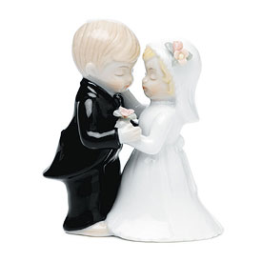
Analytics and SEO?
Web Analytics is measuring and assessment of website traffic and user experience in order to understand and improve the website. For SEO that means improving
search ranking and using analytics to tell us how effective we are at it. They are a marriage made in heaven.

Slide 26
Questions?

